Slide 1
Learning objectives for concept mapping based on the complete Bloom’s Taxonomy to promote meaningful learning
James Gorman
Nipmuc Regional High School, Upton, Massachusetts, USA

Slide 2
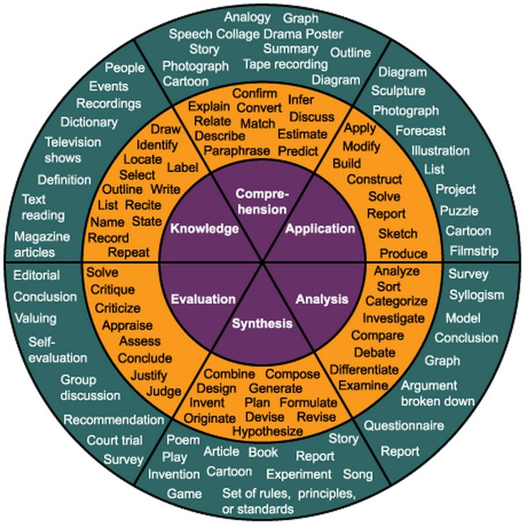
Impetus for this work
As a teacher, there is very few learning objectives published about concept mapping
Not many papers ground concept mapping in Bloom’s Taxonomy which is what teachers are use during instructional design.

Slide 3
Goal of this work
Provide specific and measurable learning objectives for concept mapping based on the complete Bloom’s Taxonomy (cognitive, interpersonal, affective, psychomotor, and perceptual domains).

Slide 4
EDUCATIONAL THEORY BACKGROUND
1
Ausubel, Novak & Bloom

Slide 5
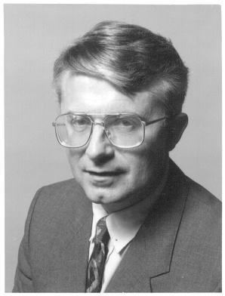
Meaningful Learning Requirements
In order for a learner to acquire new knowledge he/she must possess relevant prior knowledge
Concepts need to be presented in a manner that the learner finds them meaningful
Learning only happens if the learner chooses to learn.
David Ausubel
https://alchetron.com/cdn/david-ausubel-005b37a6-0b4a-4759-aabc-94c7571031e-resize-750.jpeg
from Novak (1998)

Slide 6
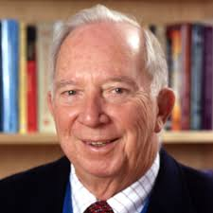
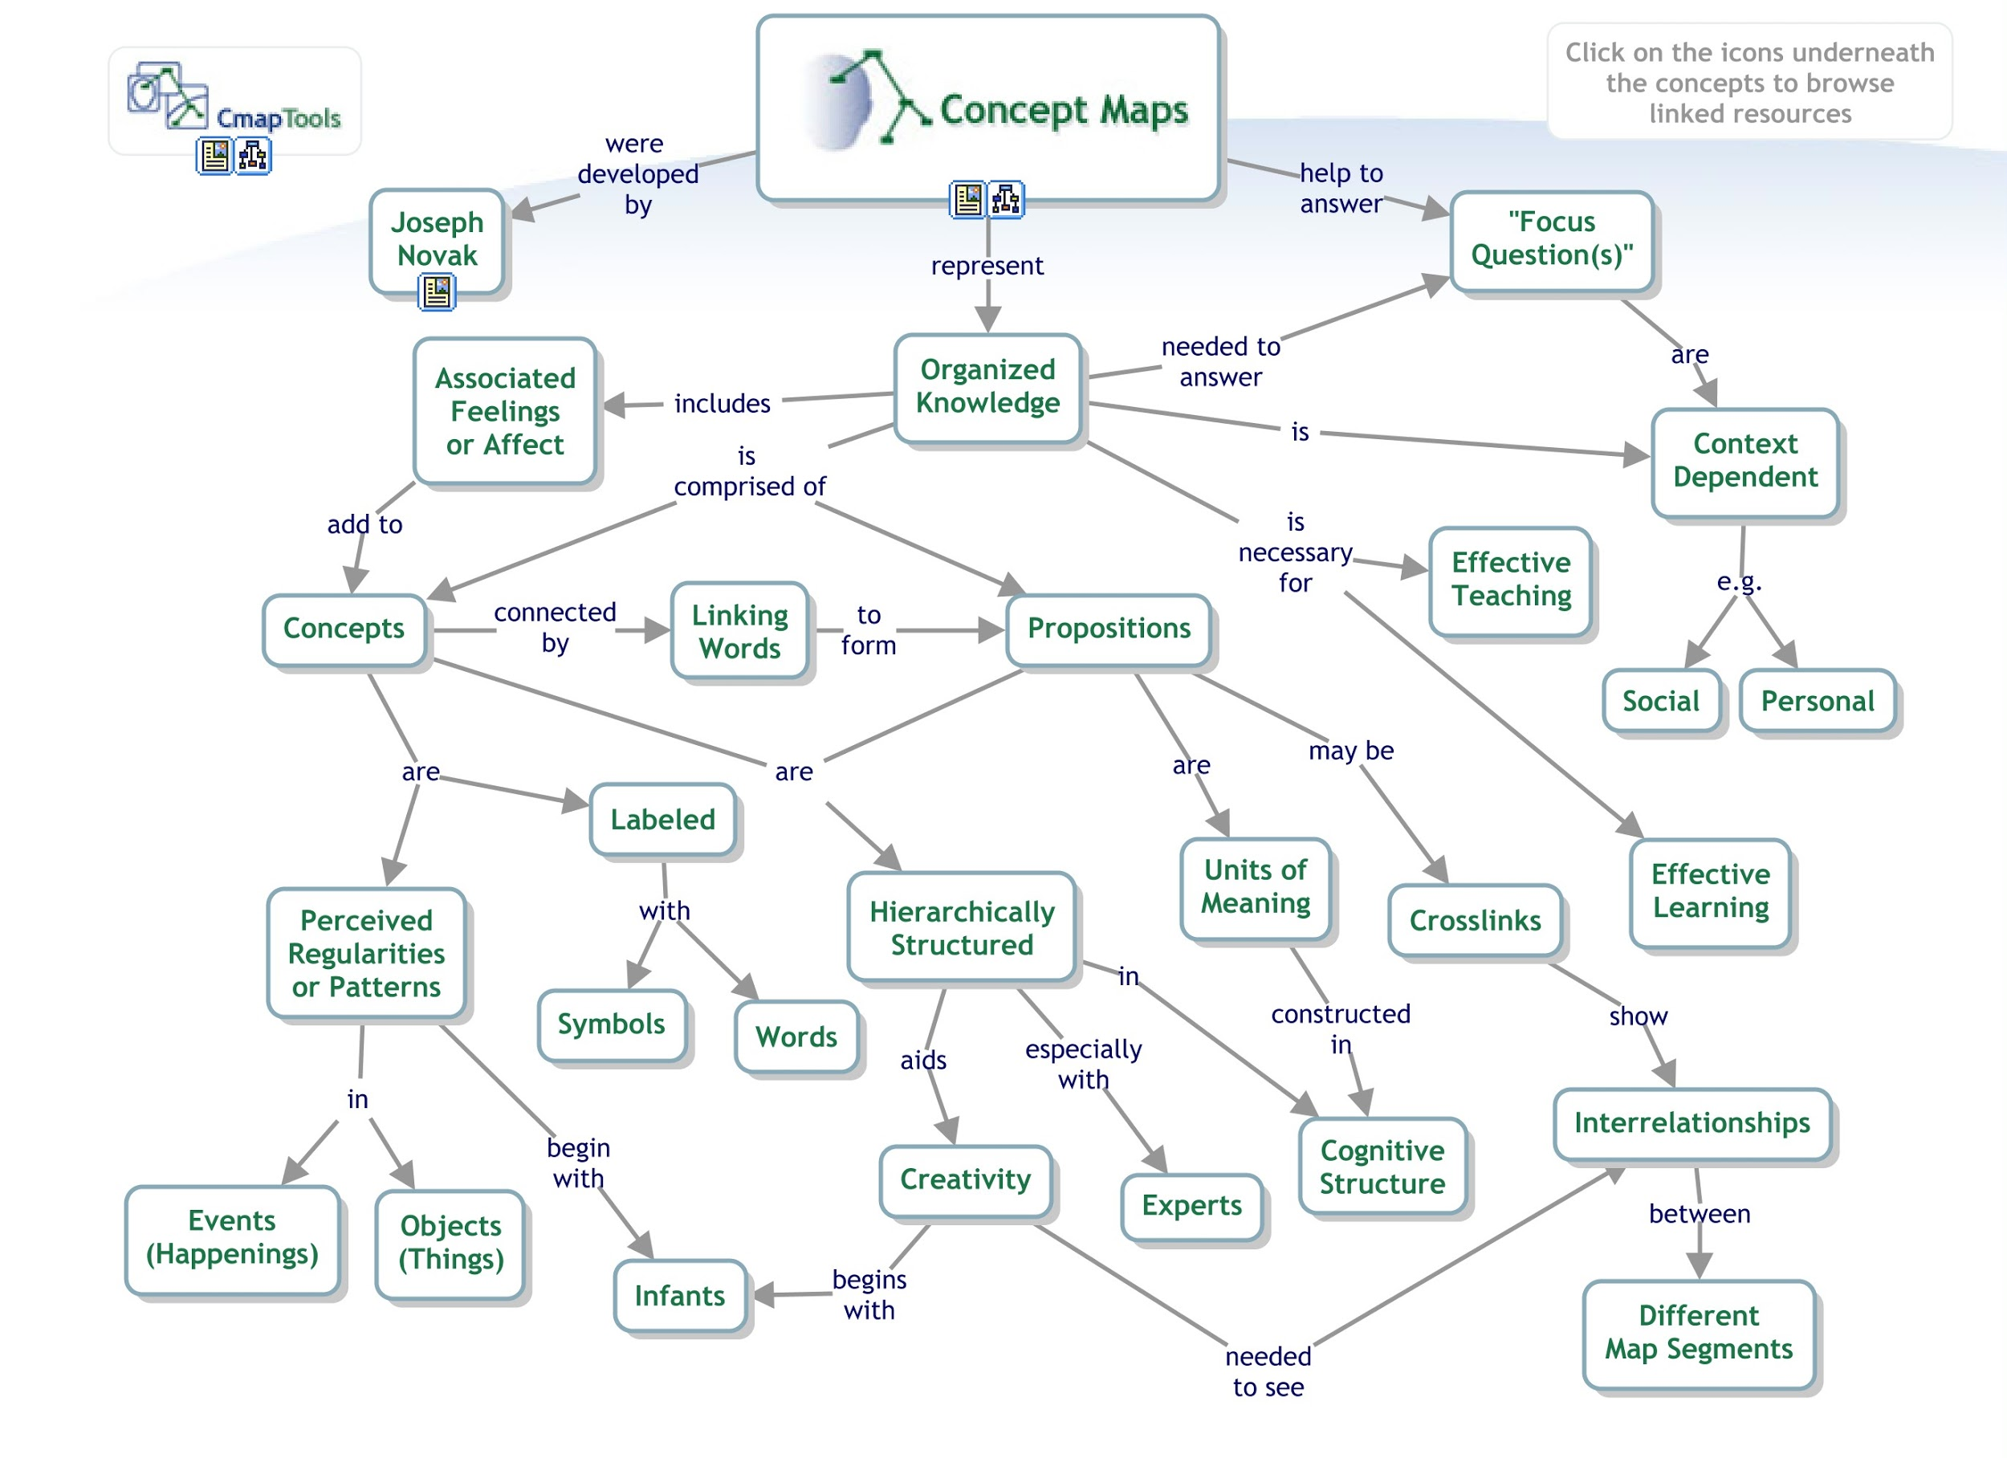
Meaningful Learning & Concept Mapping
Joseph Novak
Key Features
Hierarchical
progressive differentiation
integrative reconciliation
Negotiated meaning
cmap available at: http://cmapskm.ihmc.us/viewer/cmap/1064009710027_1483270340_27090

Slide 7
Freedom of structure and freedom of content conditions during concept mapping
from Cañas et al. (2012)

Slide 8
Bloom’s Taxonomy of Learning Domains
In 1956, Benjamin Bloom et al. developed a framework for understanding and communicating about learning objectives
Bloom’s Taxonomy has 2 dimensions: domain and level
Domains:
Cognitive
Psychomotor
Affective
Interpersonal
Perceptual
Notes:
Talk about how each of these domains are important and how teachers are mostly focused on cognitive domain however meaning learning theory would point to the importance of engage as many of them as we can.

Slide 9
TRANSLATING THEORY TO PRACTICE
2
Breaking down the domains into learning objectives

Slide 10
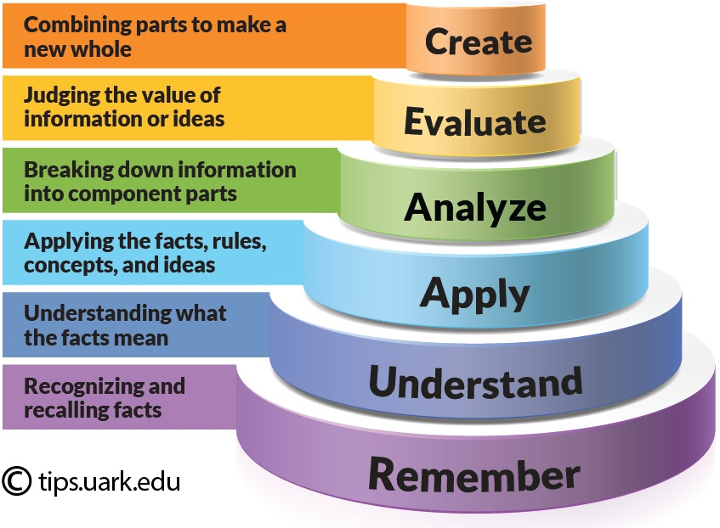
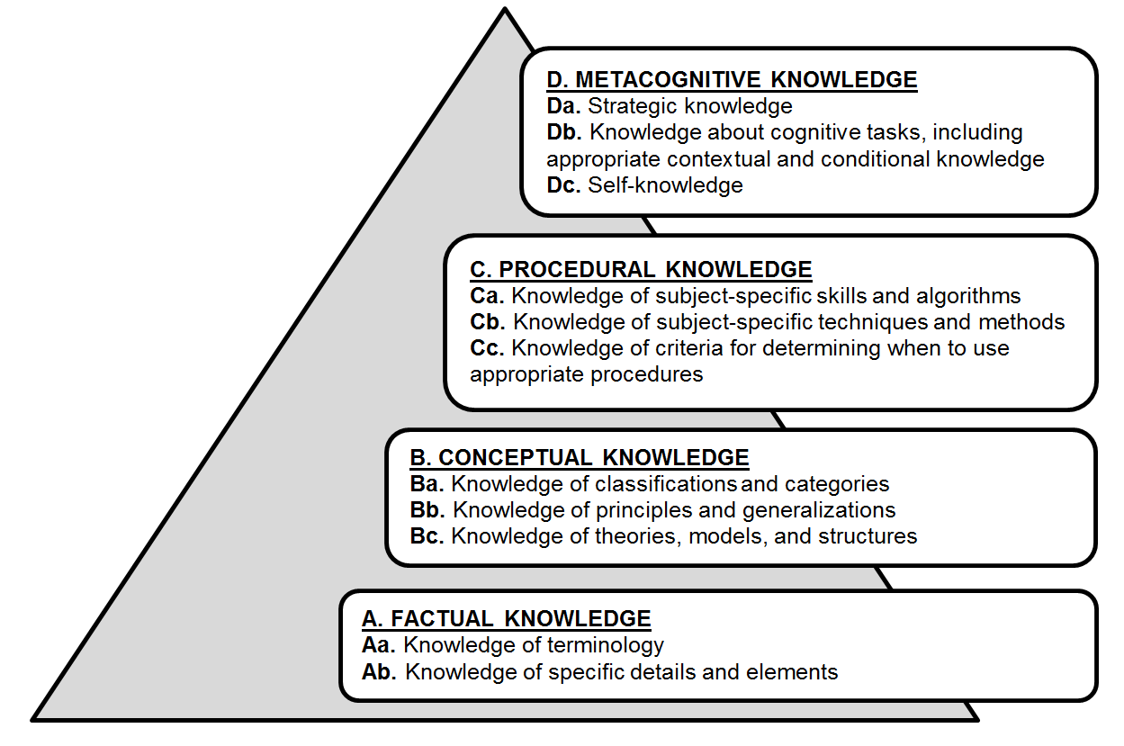
Revised Cognitive Domain - Two Dimensions
Cognitive Processes
Types of Knowledge

Slide 11
Learning Objectives for Lower-order Thinking Skills
 |  | Knowledge Dimension
 |  | Factual | Conceptual | Procedural | Metacognitive
Cognitive Process Dimension | Apply | Respond to questions relying on a concept map | Provide advice to another concept mapper. | Apply rules (e.g., concepts in circles, linking phrase on line, etc.) to a set of propositional phrases. | Choose concepts from a text and linking phrases & Decide whether the cmap is helpful
 | Understand | Generalize from a perceived regularity to label a concept | Classify concepts into appropriate groupings. | Summarize the steps to construct a cmap | Make a prediction based on cmap
 | Remember | List relevant concepts & Define a concept | Recognize what is already represented in the cmap and what might be useful to more fully address the focus question. | Recall how to construct a cmap | Identify cmaps as a way to retain knowledge and express their understanding to others.

Slide 12
Learning Objectives for Higher-order Thinking Skills
 |  | Knowledge Dimension
 |  | Factual | Conceptual | Procedural | Metacognitive
Cognitive Process Dimension | Create | Add resources (e.g., web links, videos, pictures, etc.) to a cmap in support of the concepts it details | Restructure conceptual understanding through integrative reconciliation | Compose a cmap/ knowledge model. | Negotiate meaning with other learners
 | Evaluate | Select the most appropriate 15-25 concepts to answer focus question & Rank order concepts | Assess the validity of propositional phrases relative to the focus question. | Evaluate the appropriateness of using concept mapping. | Reflect on how well the cmap concisely addresses the focus question
 | Analyze | Outline a text into a series of propositional phrases | Progressively differentiate between concepts | Organize a cmap to be aesthetically pleasing | Analyze a cmap for evidence of meaningful learning

Slide 13
Interpersonal Domain
Fournier et al. (2008) stipulated that the interpersonal domain is context specific and characterized by patterns of behavior and attitudinal dispositions toward others.
Examples include:
Listening Speaking
Writing non-verbal communication
Assertiveness managing interpersonal stress
group decision making problem solving
understanding the causes of communication failures

Slide 14
Learning objective for Lower-order Interpersonal Skills
Seeking and Giving: “SWBAT ask and offer concepts and clarification from others while constructing a cmap.”
Proposing: “SWBAT present their concept map to others and not impose it but use the cmap as the start of a conversation.”
Supporting: “SWBAT provide support to others during the concept mapping process.”

Slide 15
Learning objective for Higher-order Interpersonal Skills
Including: “SWBAT ask for opinions from others and welcome their feedback.”
Disagreeing: “SWBAT to offer a contradictory opinion considerately.”
Summarizing: “SWBAT be an active listener during the concept mapping process.”

Slide 16
Affective Domain
Described by Kratwohl et al. (1964) as the way people react emotionally and their empathy focusing on the awareness and growth in attitude, emotion, and feelings.
Crucial domain to tap into for meaningful learning to occur

Slide 17
Learning objective for Affective Domain
Receiving: “SWBAT pay attention to and attend to concepts.”
Responding: “SWBAT willingly participate in the concept mapping process.”
Valuing: “SWBAT express the value they see concept mapping providing them.”
Organization: “SWBAT organize concepts and linking lines into a cmap so that it is visually pleasing.”
Characterization: “SWBAT incorporate concept mapping into their learning process.”

Slide 18
Psychomotor Domain
Kilber et al., (1970) and Simpson (1971) were one of the first to elaborate the psychomotor domain
Associated with physical skills like speed, dexterity, grace, use of instruments, expressive movement, dance, and athletics.
https://encrypted-tbn0.gstatic.com/images?q=tbn:ANd9GcQNJcyasFTanwguooKLSqFtcjfMvvOvMIP1KlKqGHu0wgyy1M5f

Slide 19
Learning objective for Psychomotor Domain
Movement: “SWBAT point to concepts and linking phrases.”
Coordination: “SWBAT write, sketch, or type a concept map.”
Performance: N/A
Adaptation: N/A
Origination: N/A

Slide 20
Perceptual Domain
Moore (1967) states that the perceptual domain involves extraction of information from stimuli.
Key to developing expertise as experts efficiently filter out important information and recognize patterns in that information.
Perceptual learning is task specific and occurs mostly non-verbally.

Slide 21
Learning objective for Perceptual Domain
Sensation: “SWBAT label the what he/she is able to sense by taste, touch, sight, hearing, and smell.”
Figure Perception: “SWBAT recognize key structural components of a concept map (e.g., spoke, chain, network, and cycle).”
Symbol Perception: “SWBAT name and classify concepts.”

Slide 22
Learning objective for Perceptual Domain 2
Perception of Meaning:
“SWBAT evaluate a concept map and establish new relationships between previously unconnected concepts.”
“SWBAT provide advice based on a concept map.”
Perceptive Action: “SWBAT review a cmap and help guide the concept mapper.”

Slide 23
EXAMPLE CONCEPT MAPPING ACTIVITIES
3
Using learning objectives to better understand level of meaningful learning

Slide 24
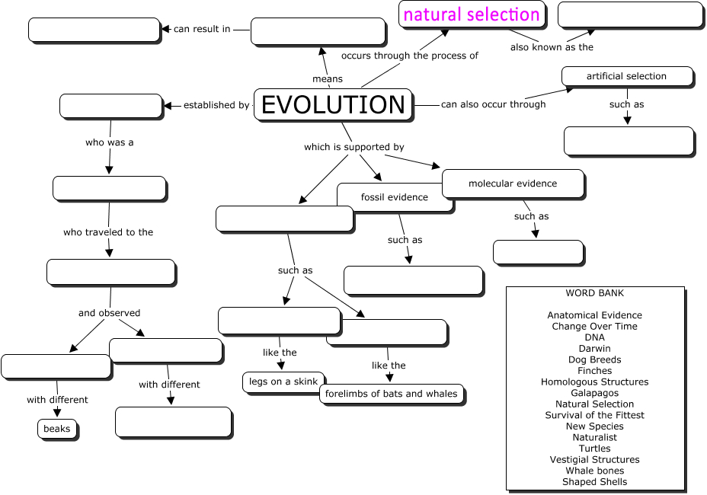
Common Textbook Chapter Review Activity
Cmap from https://www.biologycorner.com/worksheets/evolution_concept_key.html

Slide 25
“Fill in the blank” Concept mapping activity
Cognitive Domain
Knowledge Dimension | Process Dimension | Remember | Understand | Apply | Analyze | Evaluate | Create
Factual Knowledge |  | ✔
Conceptual Knowledge |  | ✔ | ✔ |  |  | ✔
Procedural Knowledge |  | ✔
Metacognitive Knowledge
Interpersonal Domain |  | Seeking/Giving | Proposing | Supporting | Including | Disagreeing | Summarizing
Affective Domain |  | Receiving ✔ | Responding ✔ | Valuing | Organization | Characterizing
Psychomotor Domain |  | Movement ✔ | Coordination ✔ | Performance | Adaptation | Origination
Perceptual Domain |  | Sensation | Figure/Ground | Symbol ✔ | Meaning ✔ | Action

Slide 26
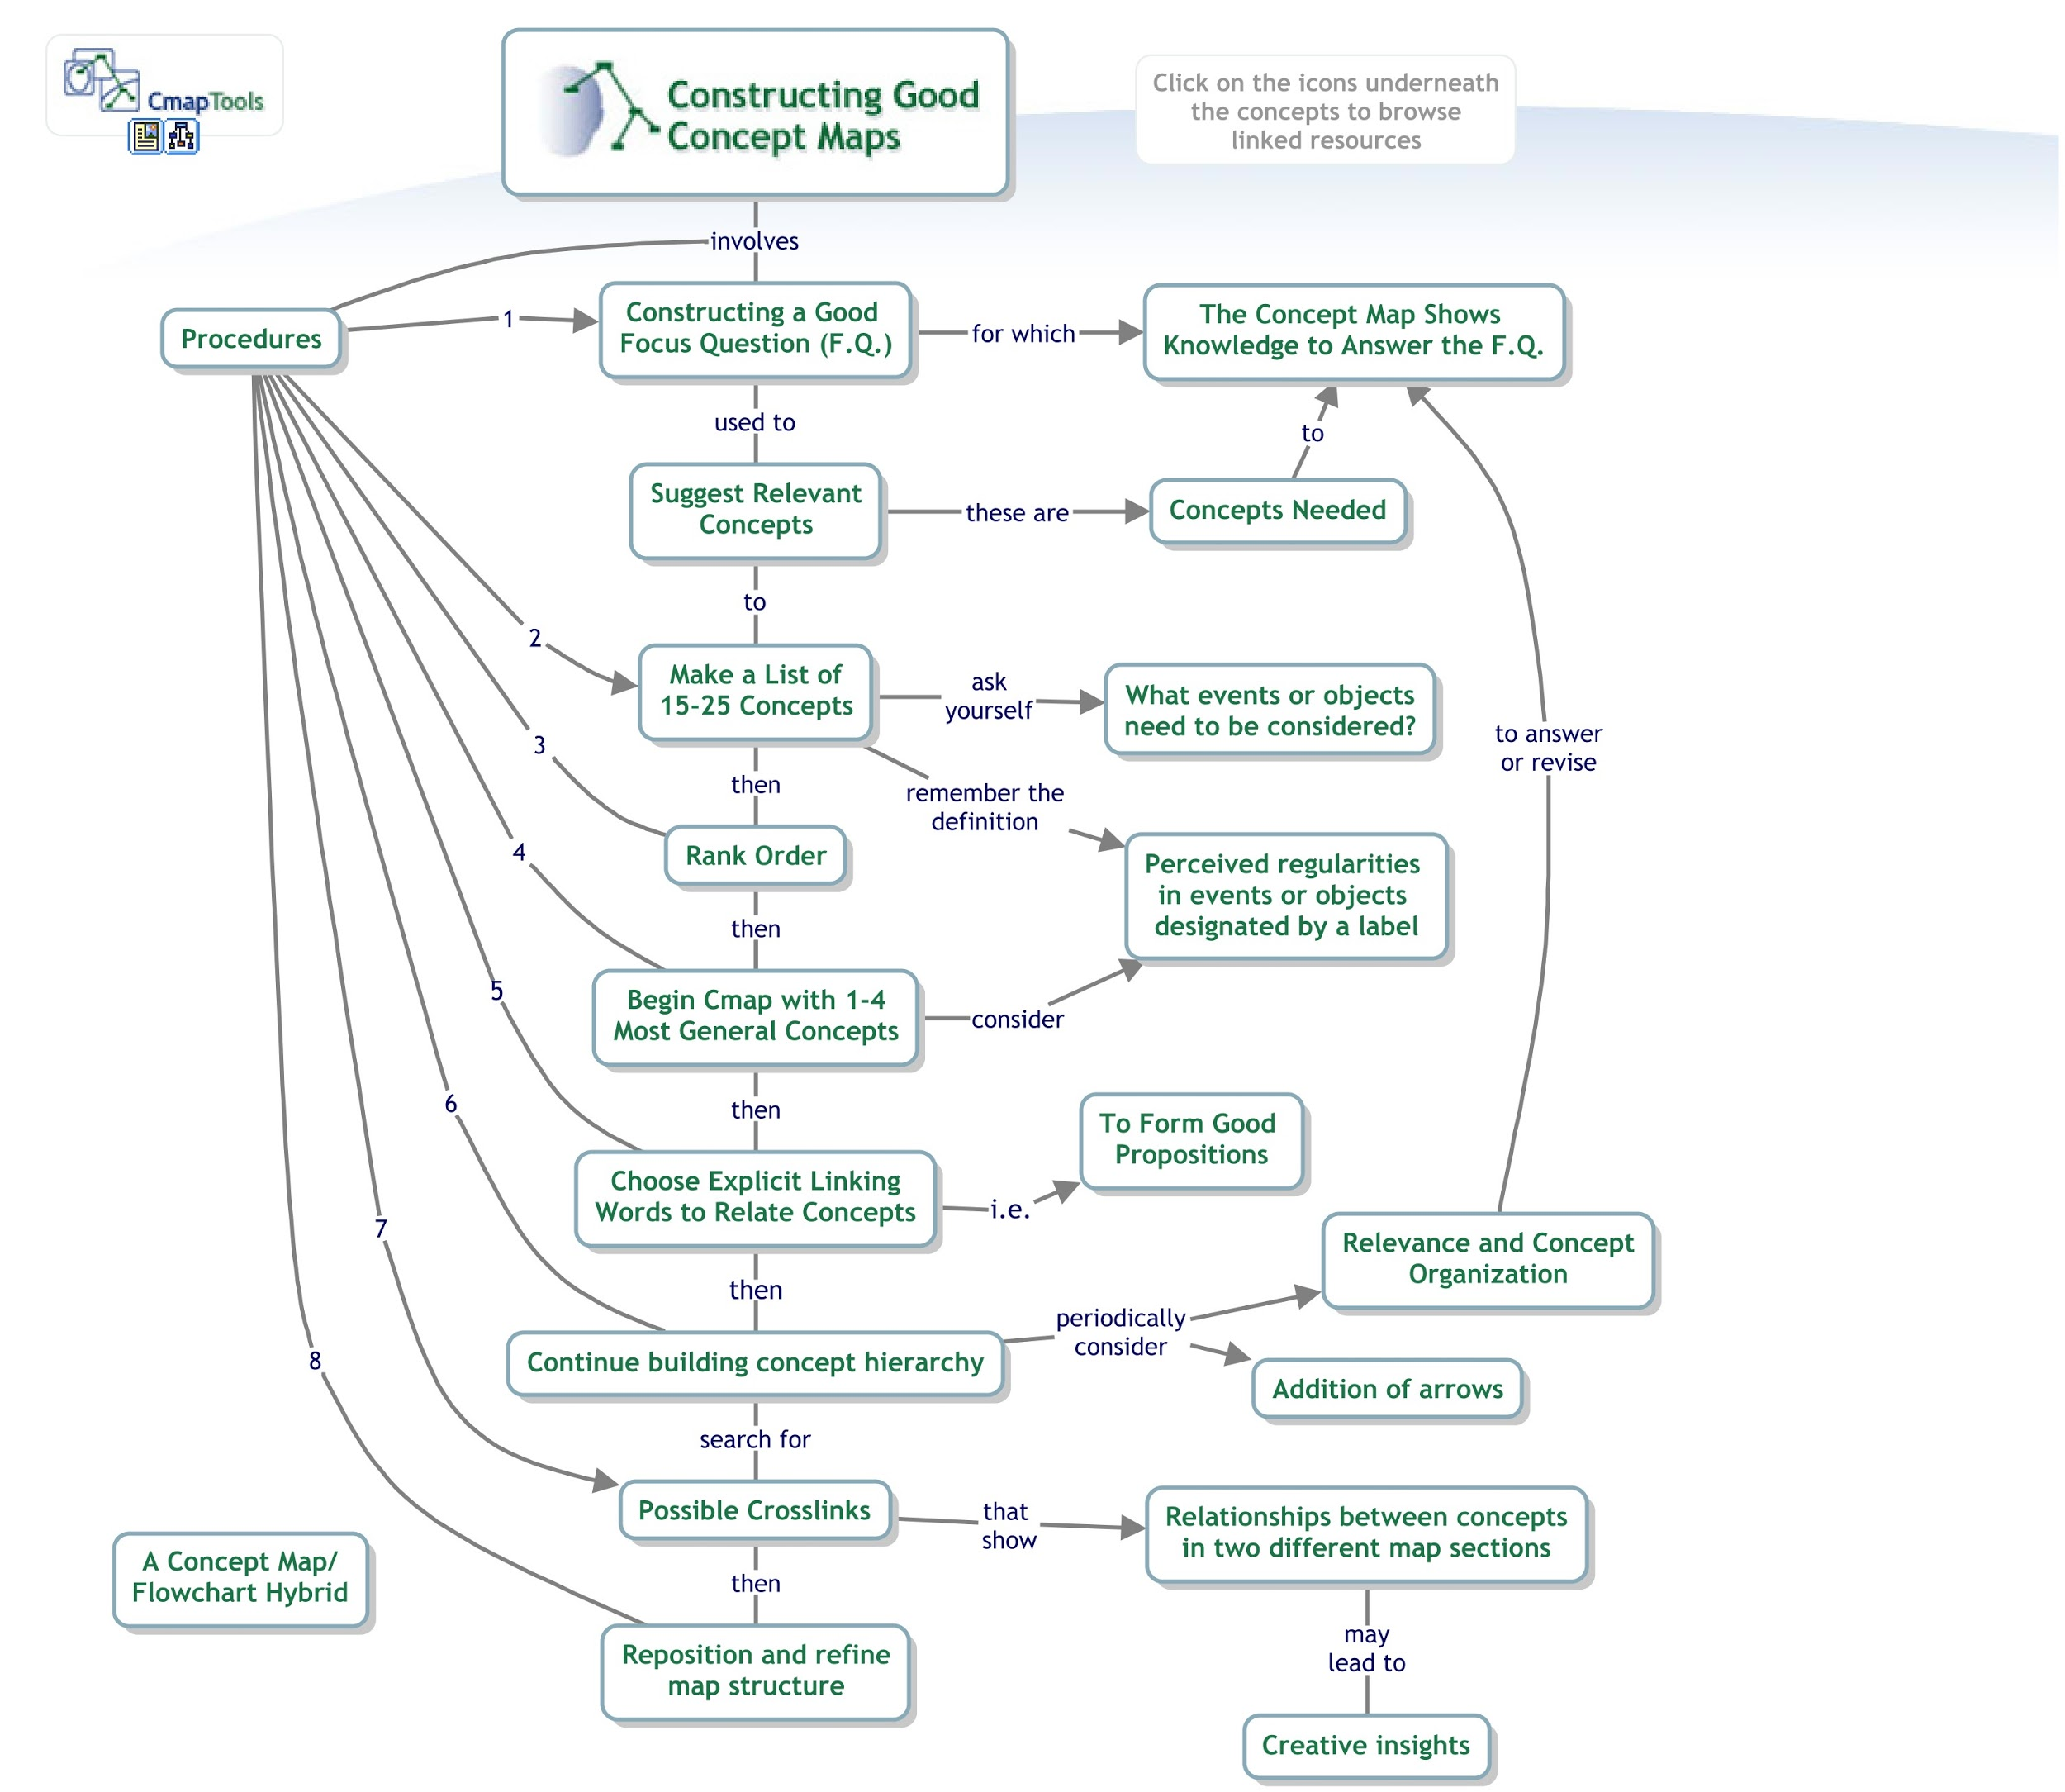
Better concept mapping activity
cmap available at: http://cmapskm.ihmc.us/viewer/cmap/1064009710027_279131382_27088

Slide 27
Better Concept mapping activity
Cognitive Domain
Knowledge Dimension | Process Dimension | Remember | Understand | Apply | Analyze | Evaluate | Create
Factual Knowledge |  | ✔ | ✔ |  |  | ✔
Conceptual Knowledge |  | ✔ | ✔ | ✔ | ✔
Procedural Knowledge |  | ✔ |  | ✔ | ✔ |  | ✔
Metacognitive Knowledge |  |  |  | ✔ | ✔ | ✔ | ✔
Interpersonal Domain |  | Seeking/Giving ✔ | Proposing ✔ | Supporting ✔ | Including ✔ | Disagreeing ✔ | Summarizing ✔
Affective Domain |  | Receiving ✔ | Responding ✔ | Valuing ✔ | Organization ✔ | Characterizing
Psychomotor Domain |  | Movement ✔ | Coordination ✔ | Performance | Adaptation | Origination
Perceptual Domain |  | Sensation | Figure/Ground | Symbol ✔ | Meaning ✔ | Action ✔
Notes:
yellow

Slide 28
Comparing the two concept mapping activities
Cognitive Domain
Knowledge Dimension | Process Dimension | Remember | Understand | Apply | Analyze | Evaluate | Create
Factual Knowledge |  | ✔ | ✔ |  |  | ✔
Conceptual Knowledge |  | ✔ | ✔ | ✔ | ✔
Procedural Knowledge |  | ✔ |  | ✔ | ✔ |  | ✔
Metacognitive Knowledge |  |  |  | ✔ | ✔ | ✔ | ✔
Interpersonal Domain |  | Seeking/Giving ✔ | Proposing ✔ | Supporting ✔ | Including ✔ | Disagreeing ✔ | Summarizing ✔
Affective Domain |  | Receiving ✔ | Responding ✔ | Valuing ✔ | Organization ✔ | Characterizing
Psychomotor Domain |  | Movement ✔ | Coordination ✔ | Performance | Adaptation | Origination
Perceptual Domain |  | Sensation | Figure/Ground | Symbol ✔ | Meaning ✔ | Action ✔

Slide 29
Conclusion - “how to think” rather than “what to think”
Concept mapping is easy but not frequently practiced (Bixler et al. 2015)
Educators need to see concept mapping as part of the learning process (Cañas et al., 2017)
Use the learning objectives from the paper as starting point to incorporate higher-order thinking practices with concept mapping into your instructional practices.

Slide 30
THANK YOU!
Any questions?
You can find me at
Twitter: @MrGorman1 & Email: jgorman@mursd.org

Slide 31
CREDITS
Special thanks to all thank my wife, Andrea, for her unwavering support and encouragement as well as Jane Heinze-Fry for providing feedback in the initial stage of developing this topic.
Presentation template by SlidesCarnival

